Slide 1
Simulation of Sorting Algorithms
Name:Haldhar Dwivedi
Roll Number: CED18I022
See Repo on Github

Slide 2
How To Run The code ?
To run the code : g++ project.cpp -lGL -lGLU -lglut -o project
Then run ./project
Keyboard Functionalities which are there in the code is:
1.Esc to exit
2.Press ‘b’ to start bubble sort visualization ,’s’ to start selection sort ,’i’ to start insertion sort,’m’ to start merge sort visualization

Slide 3
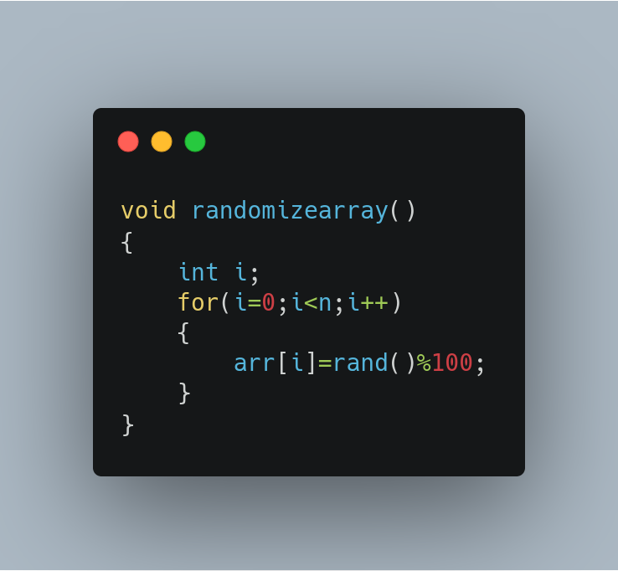
Array Initialization
For a given number/ randomized ‘n’ a randomized array is generated and displayed before the sorting algorithms are implemented

Slide 4
Sorting Algorithms
The Sorting algorithms that i implemented are
Bubble Sort
Insertion sort
Quick sort
Selection sort

Slide 5
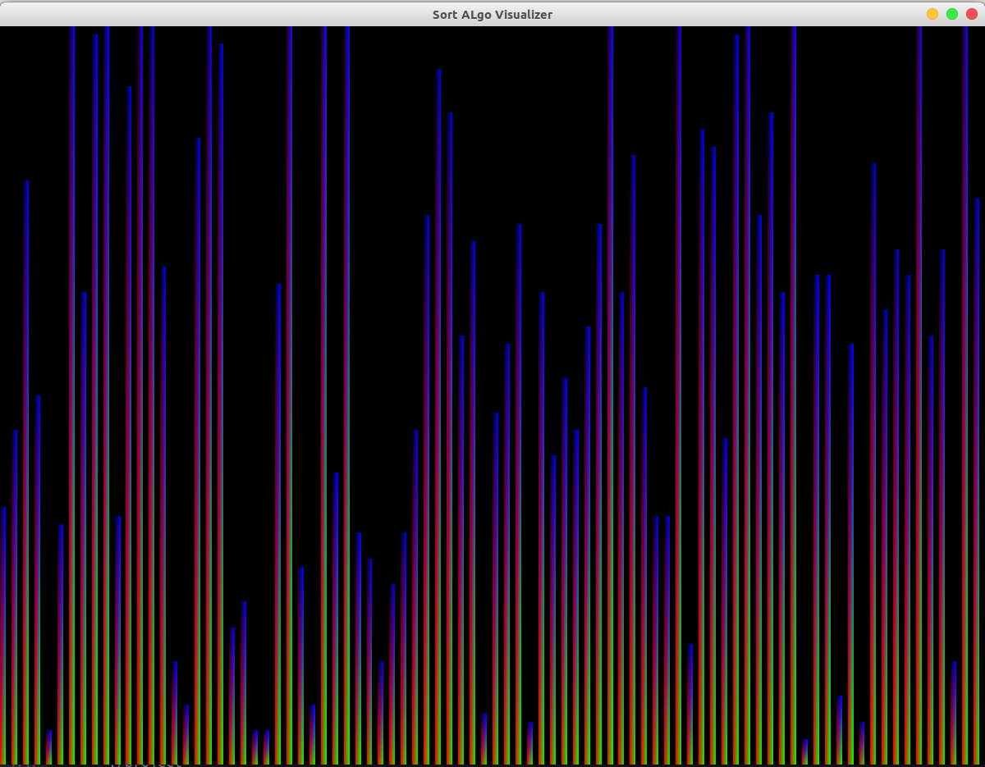
Rendering Array
To display the array as heights of the rectangle the algo used :
width=1/n
Height ratio = 2*(arr[i] + 1)/l;
widthIndexAdder = 2*i/l;
Leftx = -1 + widthIndexAdder;
Rightx = Leftx + width;
BottomY = -1;
TopY = BottomY + Height ratio;
We can then use these two diagonally opposite points to create the rectangle that will represent the array visually

Slide 6
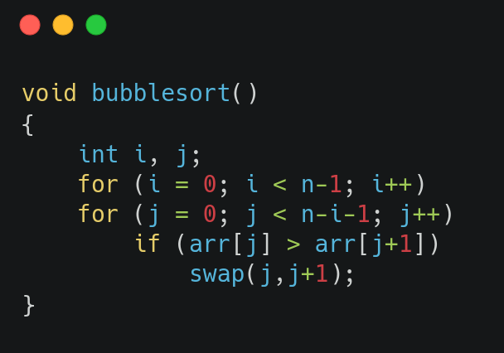
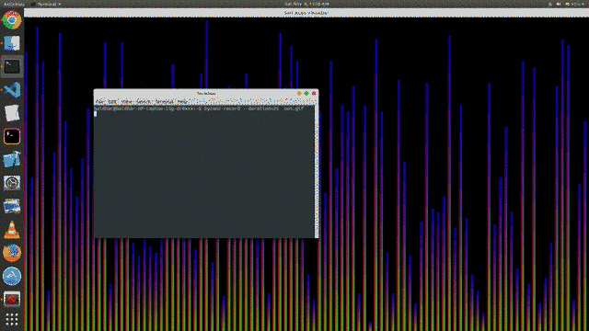
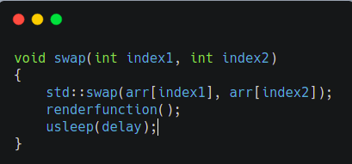
Bubble Sort

Slide 7
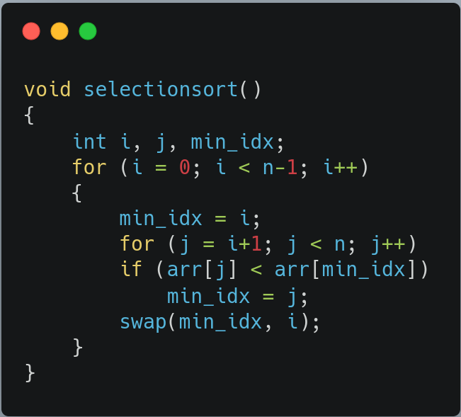
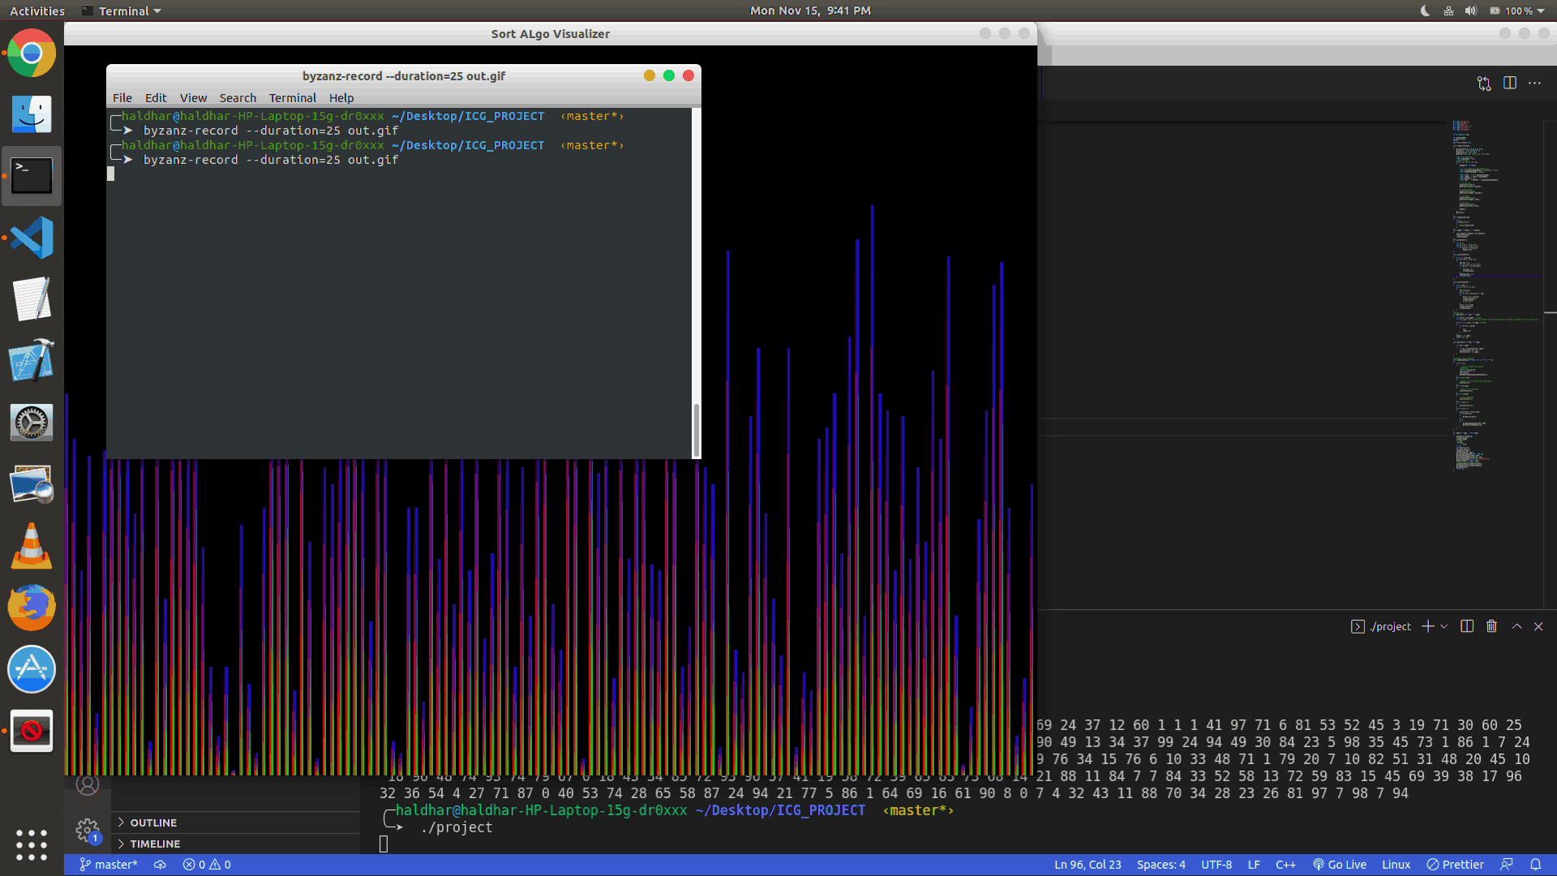
Selection Sort

Slide 8
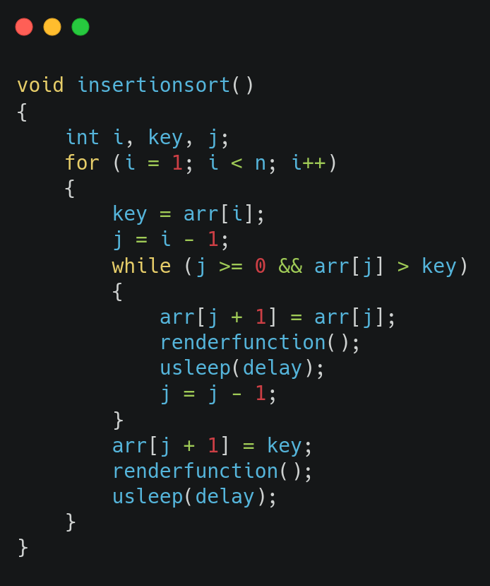
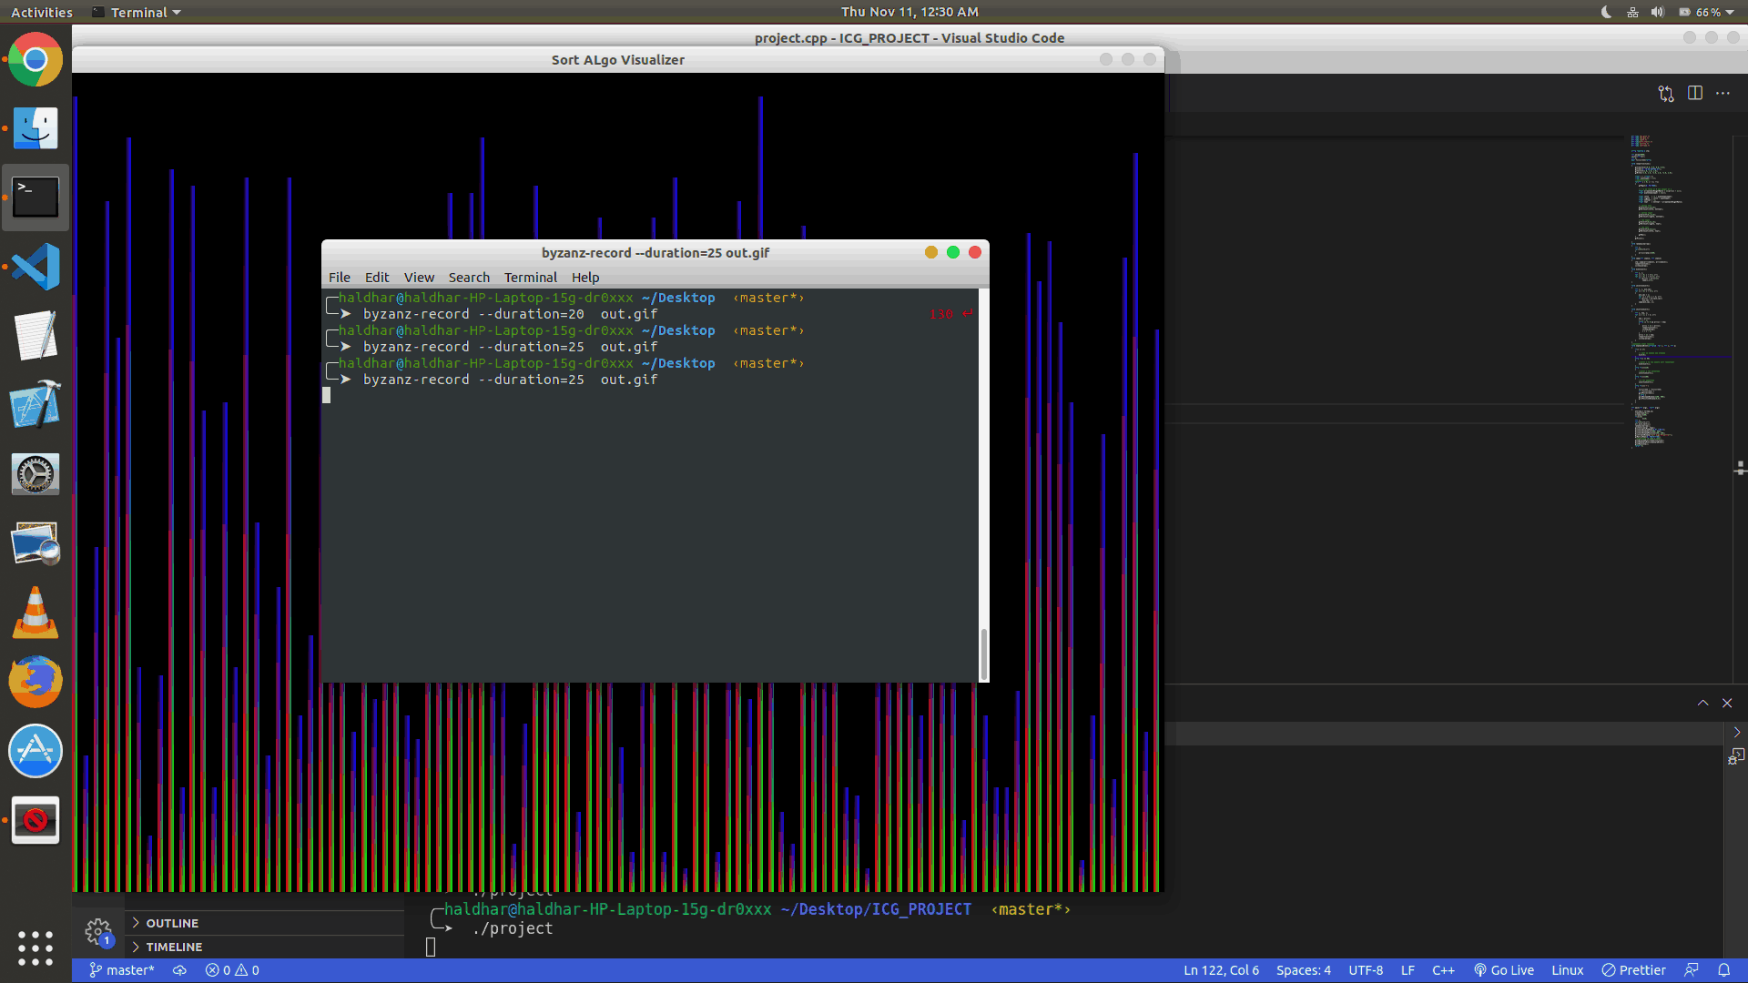
Insertion Sort

Slide 9
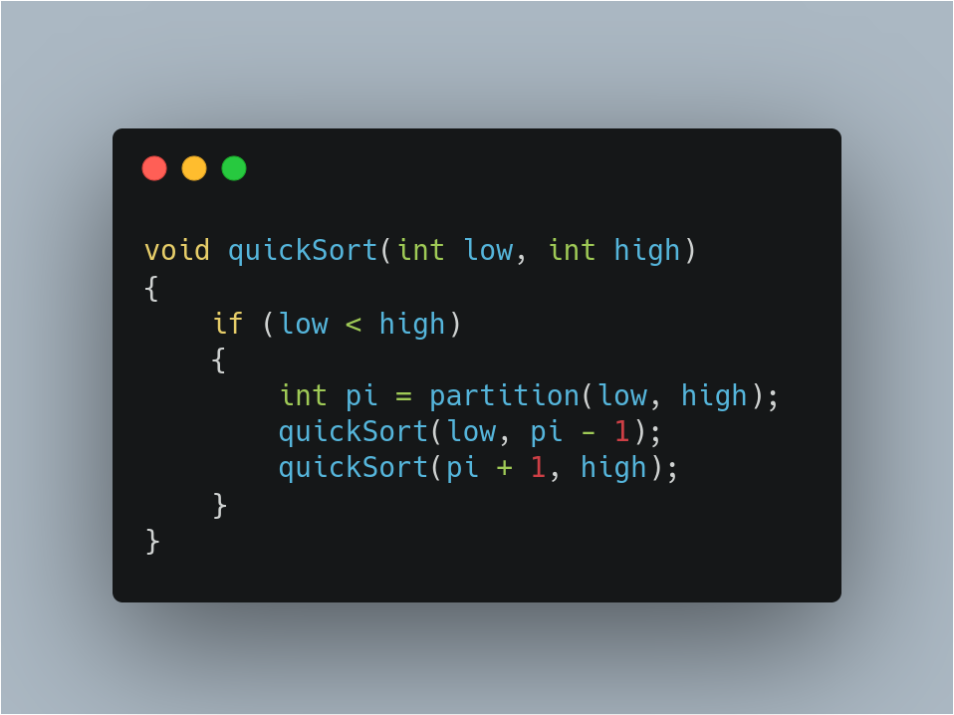
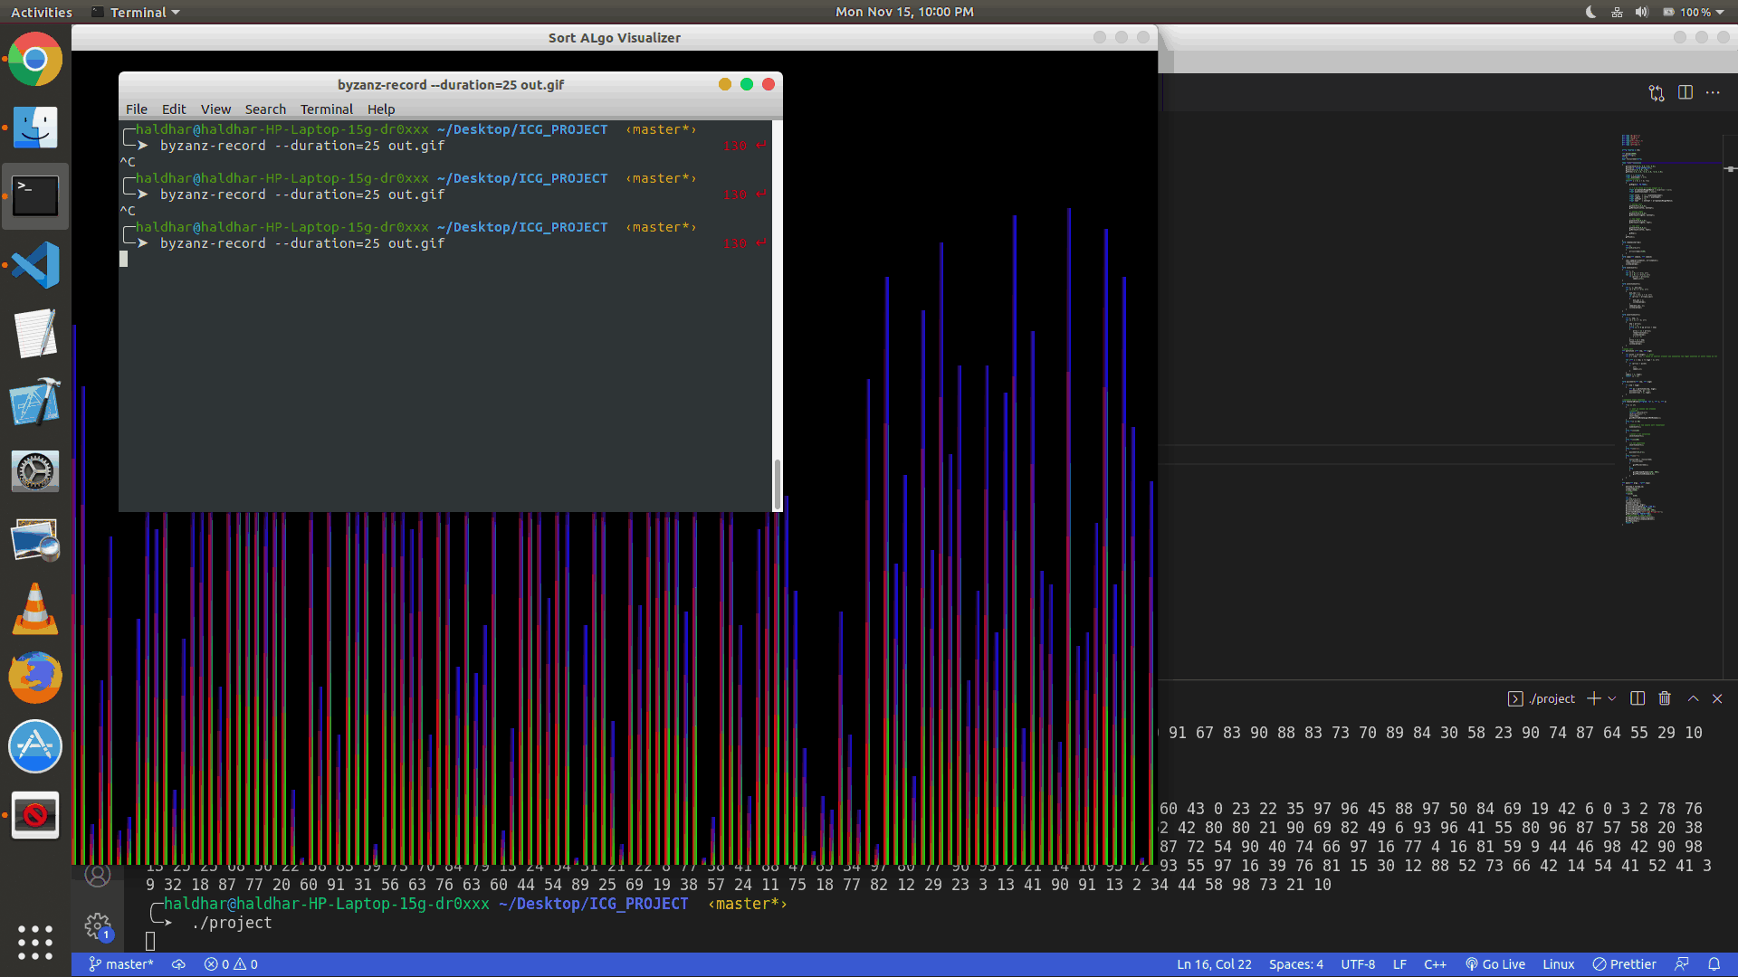
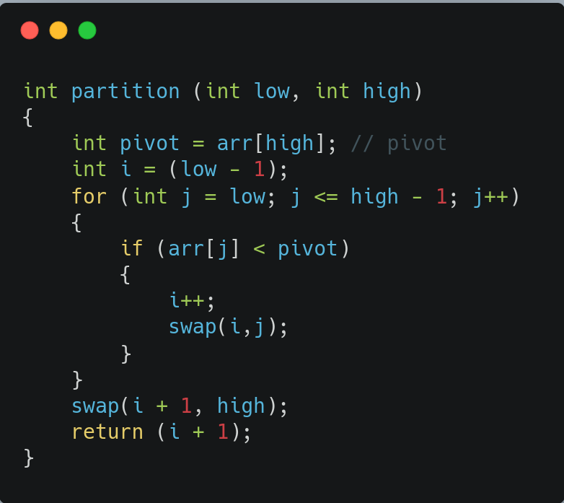
Quick Sort
Pivot For Quicksort implementation is last element

Slide 10
THANK YOU

